Slide 1

Project Grow
Environment monitoring System
By
Aonghus O’Domhnaill
Supervisor
Brian O’Shea

Slide 2
Introduction:
Purpose of project is to demonstrate environment control in an enclosed grow area.
Will effectively be able to monitor temperature, humidity, CO2, air quality and light intensity.
In the water will be able to monitor PH and EC.
User will then be able to control climate based on data received.
Liked this project because it’s a mix of software and hardware.

Slide 3
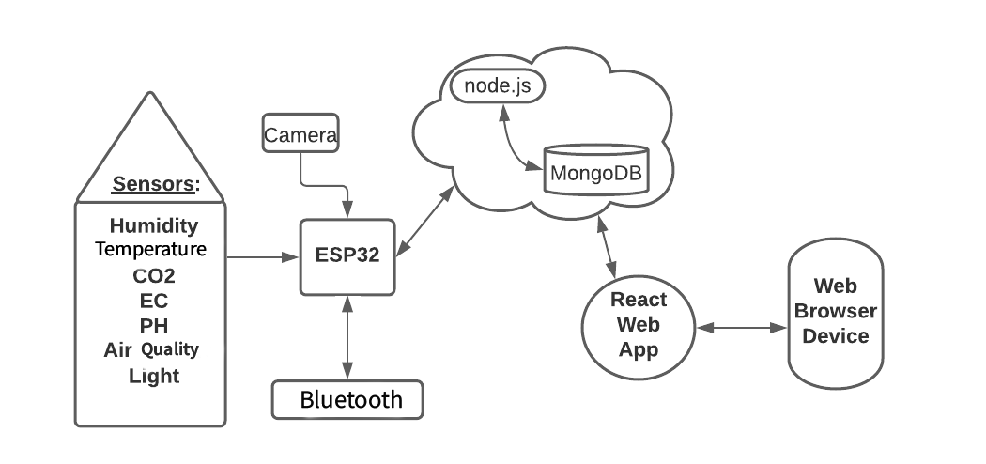
Architecture Diagram:

Slide 4
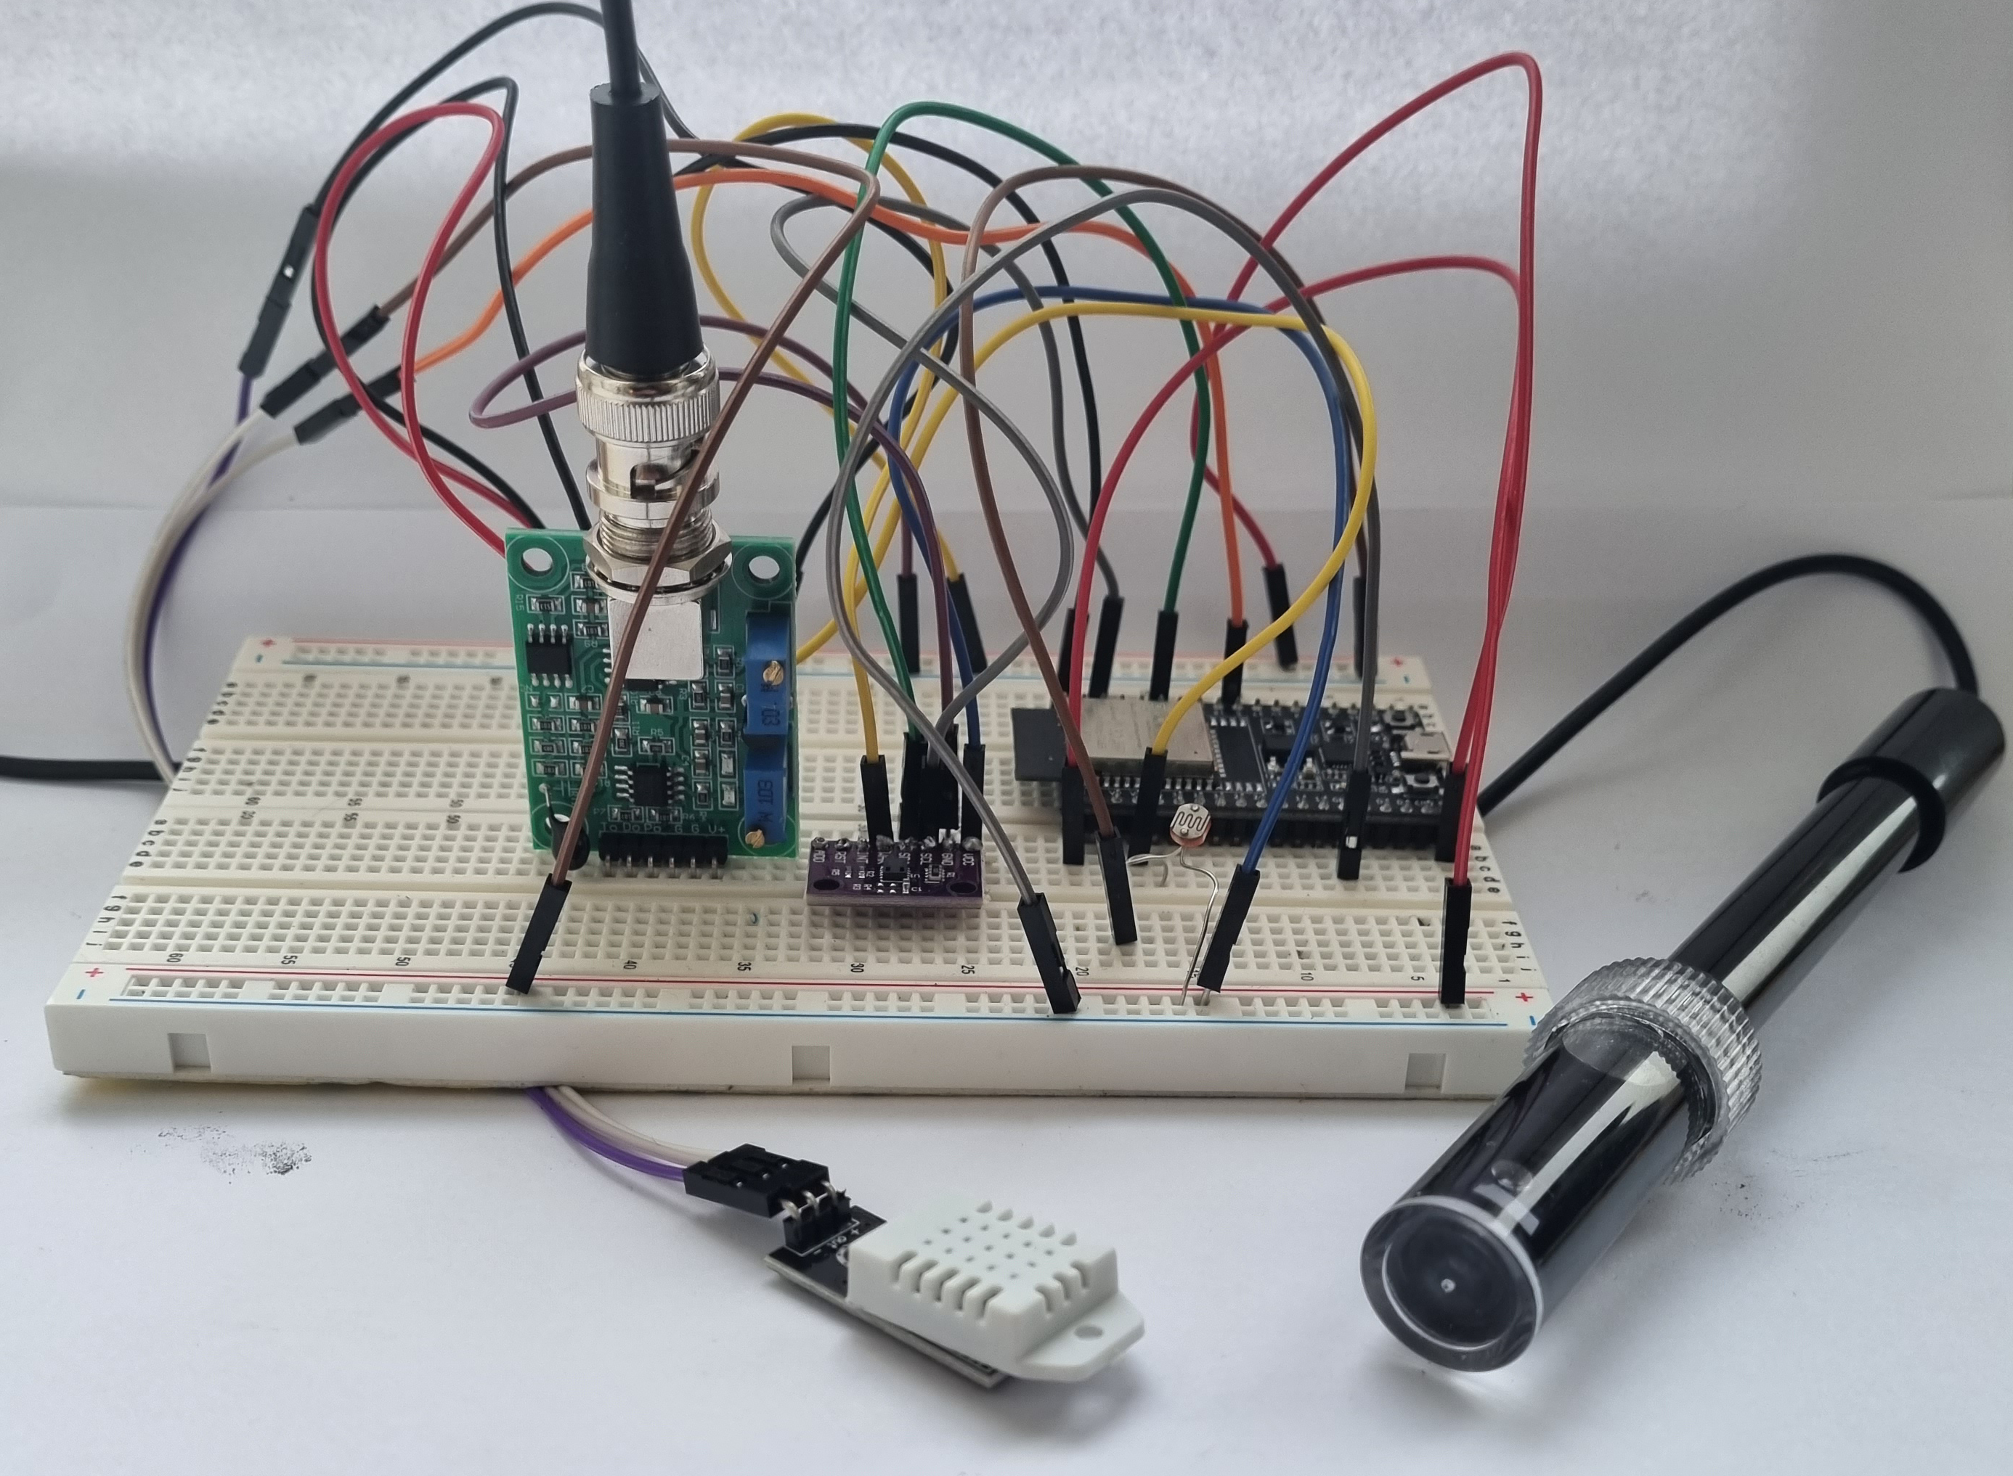
Circuit:

Slide 5
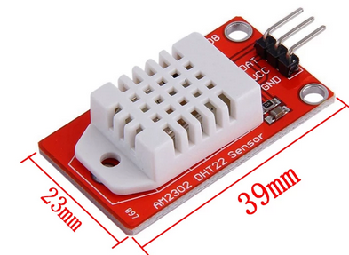
DHT22:
Digital Humidity and Temperature Sensor
Uses thermistor and humidity sensor to measure air
Sends back digital signal on data pin
Temperature Range | -40 – 125°C /± 0.5°C
Humidity Range | 0 – 100% / ± 2-5%
Sampling Rate | 0.5Hz (1 Reading every 2 secs)
Body Size | 15.1mm x 25mm x 7.7mm
Operating Voltage | 3-5V
Max Current | 2.5mA

Slide 6
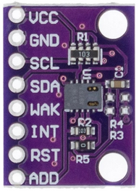
CCS811:
Digital TVOC and CO2 sensor over I²C.
Air quality monitor.
Operating Voltage | 3-5V
Max Current | 30mA
Power Consumption | 60mW
Operating Temperature | -5-50°C
Operating Humidity | 10-95%

Slide 7
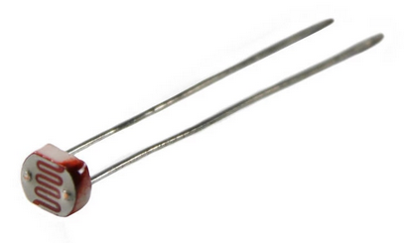
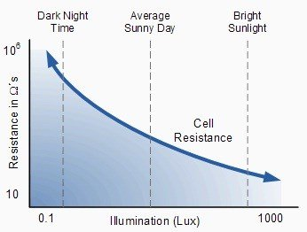
LDR:
Light Dependent Resistor: Decreases resistance when component
receives light.

Slide 8
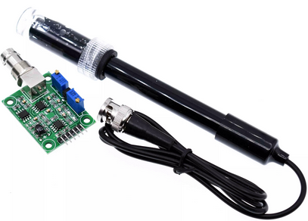
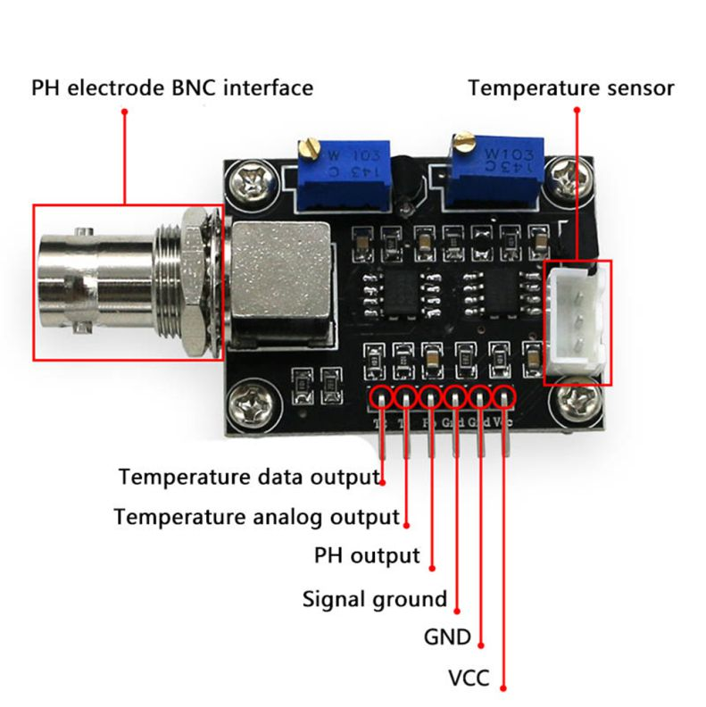
PH Sensor Module:
PH sensor that measures analog voltage signal.
Measures water temperature also.
Operating Voltage | 5V
Max Current | 5-10mA
Power Consumption | 0.5W
Detectable Range | PH 0-14
Detectable Temperature | 0-80°C

Slide 9
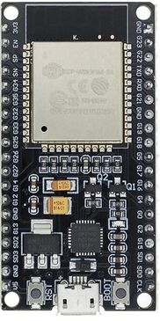
ESP32 with Wi-Fi and Bluetooth:
Cores | 2
Architecture | 32bit
RAM | 512 kB
FLASH | 16 MB
GPIO Pins | 36
Busses | SPI, I²C, I²S, CAN, UART
DAC Pins | 2
ADC Pins | 18
Power Consumption | 160-260mA
Deep Sleep | .001mA

Slide 10
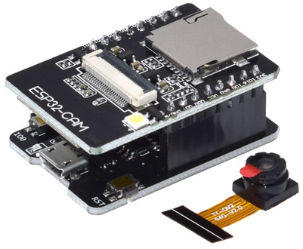
ESP32 CAM:
Take pictures daily to monitor and record progress.
Use images to show timelapse on website.
Operating Voltage | 5V
Power Consumption | 180mA
Deep-Sleep Usage | 6mA

Slide 11
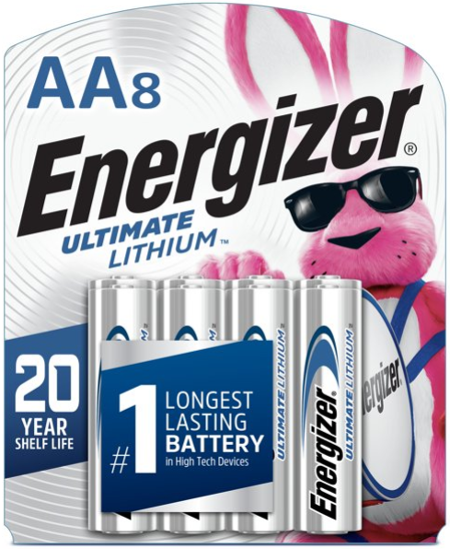

Power:
Lithium batteries will be used as power source.
Lithium batteries stay consistent voltage all the way up
to 90% usage. So they are ideal for low powered system.
2 AA 1.5V will be used for the 3.3V port.
3 AA 1.5V will be used for 5V port and ESP32 CAM.
Works well at extreme temperatures.
$\frac{\begin{aligned} \\ \\ 7000mAh \end{aligned}}{200mAh}$ = 35hrs = 126,000secs ÷ 120 1050 days

Slide 12
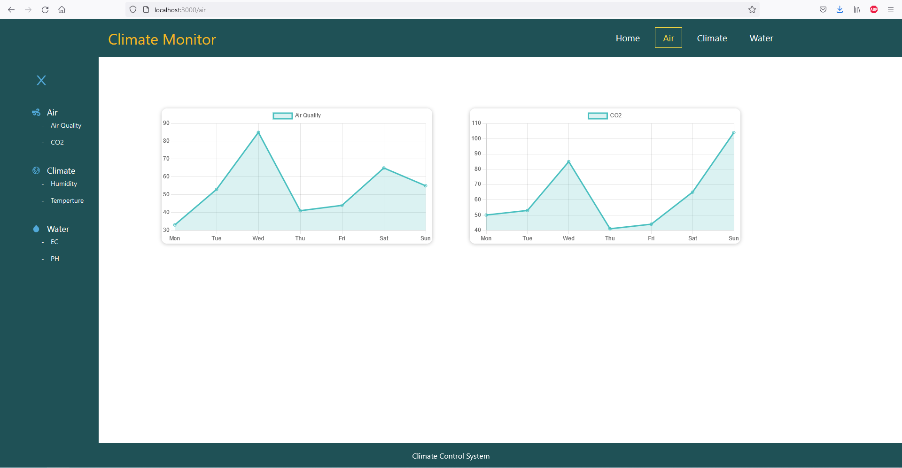

Slide 13
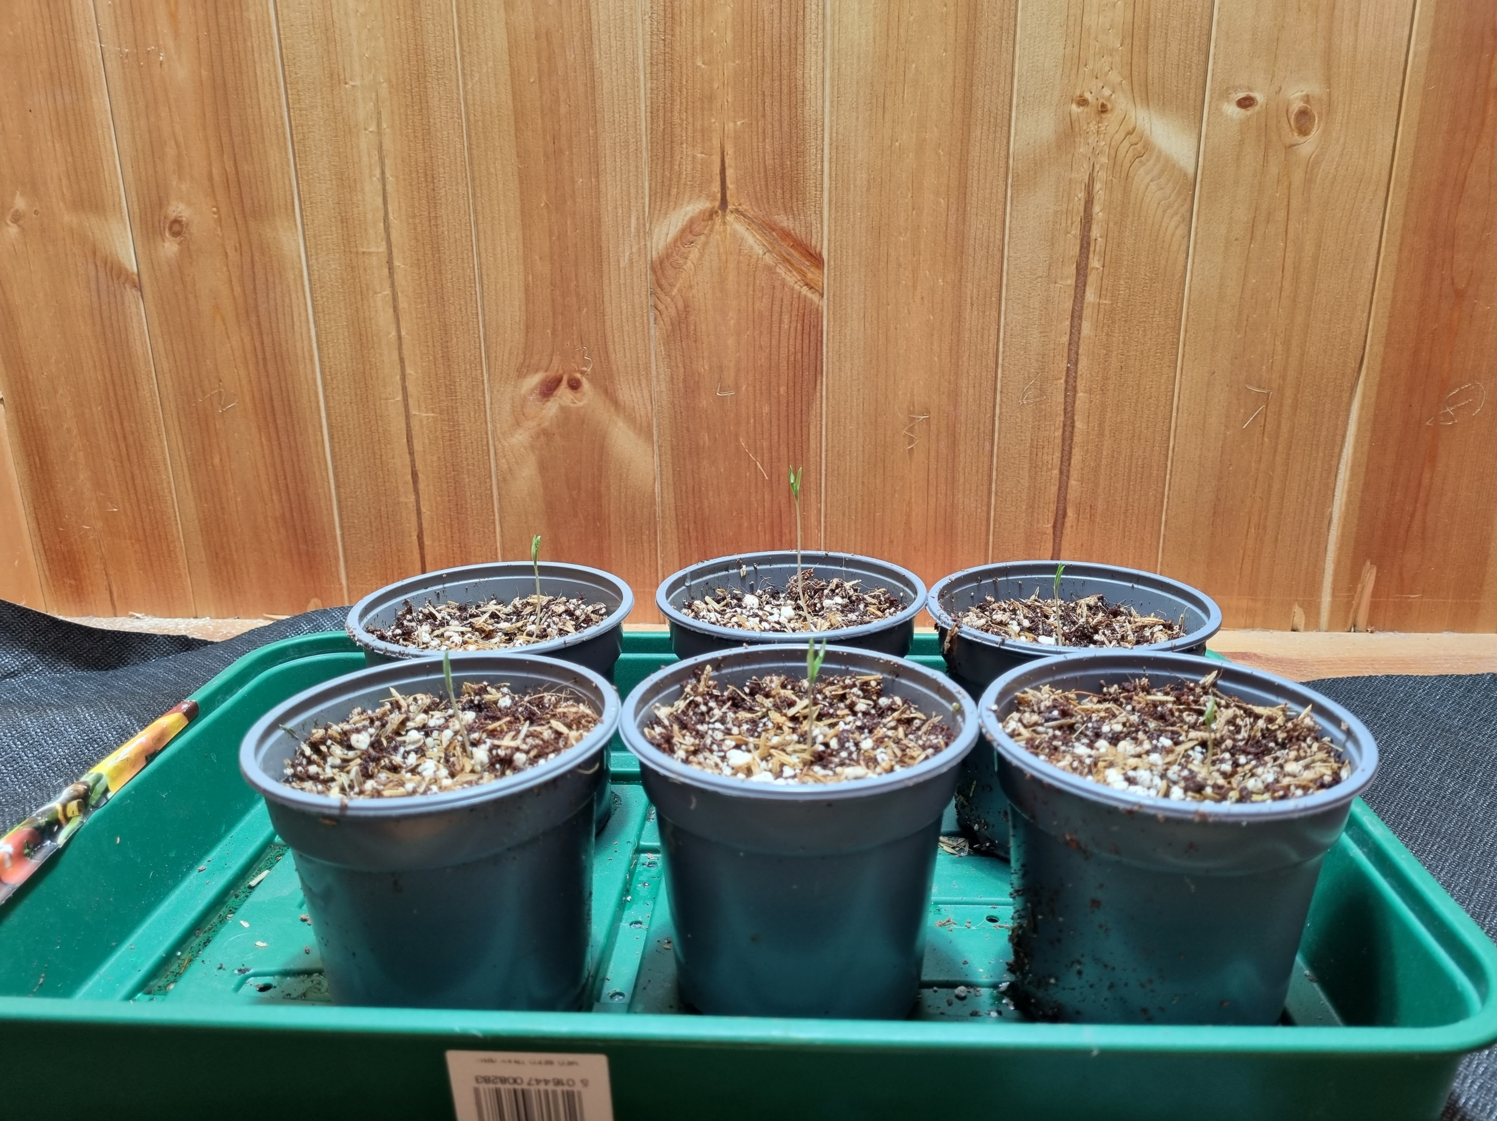
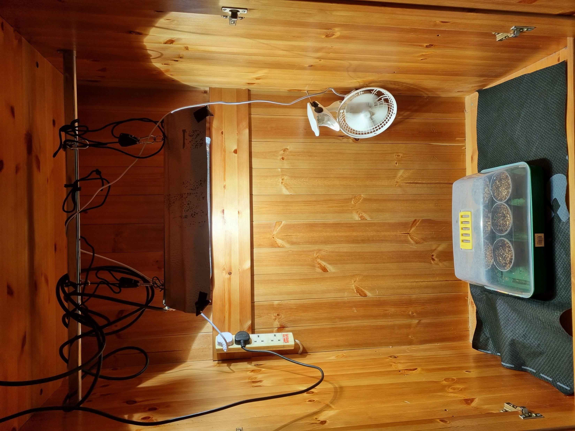

Slide 14


